Slide 1
Use Terraform to Provision Your Own Cloud-Based Remote Browsing Workstation
SANS Tech Tuesday Workshop March 2, 2021
Kenneth G. Hartman
Notes:
Abstract: This workshop will teach you everything you need to know to provision your own Cloud-Based Ubuntu Workstation in AWS for Remote Browsing. Sometimes there are valid security and privacy reasons to use a temporary workstation for potentially malicious websites or to avoid tracking.

Slide 2
About
Me
“I help my clients earn and maintain the trust of their customers”
Kenneth G. Hartman
BS Electrical Engineering, Michigan Technological University
MS Information Security Engineering, SANS Technology Institute
Multiple Security Certifications: CISSP, GIAC Security Expert, etc.
Certified SANS Instructor – SEC488 Cloud Security Essentials
www.kennethghartman.com
@kennethghartman
The content and opinions in this presentation are my own and do not necessarily reflect the positions, strategies, or opinions of any current or previous employer.
2
Notes:
Kenneth G. Hartman - BIO
Kenneth G. Hartman is a security consultant based in Traverse City, Michigan. Ken’s motto is “I help my clients earn and maintain the trust of their customers in its products and services.” Toward this end, he consults on a comprehensive program portfolio of technical security initiatives focused on securing client data in the public cloud. Ken has worked for a variety of Cloud Service Providers in both the Midwest and Silicon Valley in architecture, engineering, compliance, and security product management roles. An instructor for SEC545: Cloud Security Architecture and Operations and SEC488: Cloud Security Essentials, Ken has also been the co-chair of the 2019 SANS Cloud Security Operations Solutions Forum, the 2019 and 2020 SANS Cloud & DevOps Security Summits.

Slide 3
Resources
Github Repo: https://github.com/Resistor52/terraform-cloud-workstation
Slides: http://bit.ly/cloud-workstation-slides

Slide 4

Prerequisites
Attendees will need an AWS Account and should be comfortable launching an EC2 instance and connecting to it.
Here is a tutorial on launching an EC2 virtual machine instance: https://docs.aws.amazon.com/AWSEC2/latest/UserGuide/EC2_GetStarted.html

Slide 5
Learning Objectives
Understand use cases for a Temporary Cloud Workstation
Use Terraform to provision resources in AWS
Use Git to track versions of a Terraform Script
Pass ‘user data’ to configure EC2 Instance at first boot
Understand Privacy & Security Implications

Slide 6
Plan of Attack
Demonstrate the system that we will build in class
Consider the use cases of a temporary cloud workstation
Prepare our development environment and repository
Iteratively build and test the workstation, step by step
Add documentation to the repository
Discuss important privacy and security considerations

Slide 7

Demo of the
Cloud-Based
Remote Browsing
Ubuntu Workstation

Slide 8
OK, but….Umm…Why??
Have you ever been tempted to visit a website that is most likely malicious?
Every want to perform web research that is not tied to you by tracking technologies? (browser Synching, Cookies, IP Address, Browser Fingerprinting, etc.)
Ever need to circumvent geolocation restrictions?
Need to Pen Test your external perimeter, but you are inside?
Ever want to run a quick experiment in a clean environment?

Slide 9
Workshop Development Environment
ASSUMPTION:
This workshop assumes you have already established an AWS account!
SETUP:
Log into AWS CloudShell
Verify git is installed
Install Terraform

Slide 10
Use Terraform to Provision Your Own Cloud-Based Remote Browsing Workstation
Step 1:
Set up AWS CloudShell for the Workshop

Slide 11
Step 1: Set up AWS CloudShell for the Workshop
Navigate to Workbook – Step 1
https://github.com/Resistor52/terraform-cloud-workstation/blob/main/workbook/Step_1.md
Perform the Steps as Instructed in the Document
Watch the Video for Help: https://youtu.be/INC9MbsmYAM

Slide 12
Use Terraform to Provision Your Own Cloud-Based Remote Browsing Workstation
Step 2:
Create a Github Account (if you don’t have one)

Slide 13
Step 2: Create a Github Account (if you don’t have one)
NOTE: if you already have a Github account, simply login
Navigate to Workbook – Step 2
https://github.com/Resistor52/terraform-cloud-workstation/blob/main/workbook/Step_2.md
Perform the Steps as Instructed in the Document
Watch the Video for Help: https://youtu.be/3jiey--sjJ4

Slide 14
Use Terraform to Provision Your Own Cloud-Based Remote Browsing Workstation
Step 3:
Create a Github Repository

Slide 15
Step 3: Create a Github Repository
Navigate to Workbook – Step 3
https://github.com/Resistor52/terraform-cloud-workstation/blob/main/workbook/Step_3.md
Perform the Steps as Instructed in the Document
Watch the Video for Help: https://youtu.be/m5DiBfHEJ2s

Slide 16
Use Terraform to Provision Your Own Cloud-Based Remote Browsing Workstation
Step 4:
Create an AWS CLI Profile

Slide 17
Important Notes!!
Technically, the AWS CloudShell can run AWS CLI commands without running the aws configure command, but we want this script to be able to run anywhere, not just the CloudShell.
Normally, the CloudShell uses the permissions of the user who has logged into the Web Console.
DO NOT run aws configure on an EC2 instance, lest your ~/.aws/credentials file get compromised!
Since the CloudShell can only be accessed via the Web Console, running it is an acceptable risk for this workshop.

Slide 18
Step 4: Create an AWS CLI Profile
Navigate to Workbook – Step 4
https://github.com/Resistor52/terraform-cloud-workstation/blob/main/workbook/Step_4.md
Perform the Steps as Instructed in the Document
Watch the Video for Help: https://youtu.be/UlP6B4B0bUY

Slide 19
Use Terraform to Provision Your Own Cloud-Based Remote Browsing Workstation
Step 5:
Create a SSH Key Pair

Slide 20
Step 5: Create a SSH Key Pair
Navigate to Workbook – Step 5
https://github.com/Resistor52/terraform-cloud-workstation/blob/main/workbook/Step_5.md
Perform the Steps as Instructed in the Document
Watch the Video for Help: https://youtu.be/_t82air0vss

Slide 21
Use Terraform to Provision Your Own Cloud-Based Remote Browsing Workstation
Step 6:
Create a terraform.tfvars
File

Slide 22
The terraform.vars File

Slide 23
Step 6: Create a terraform.tfvars File
Navigate to Workbook – Step 6
https://github.com/Resistor52/terraform-cloud-workstation/blob/main/workbook/Step_6.md
Perform the Steps as Instructed in the Document
Watch the Video for Help: https://youtu.be/EtXHvlSiQb0

Slide 24
Use Terraform to Provision Your Own Cloud-Based Remote Browsing Workstation
Step 7:
Perform First git commit

Slide 25
Most Frequent Git Commands

Slide 26
Step 7: Perform First git commit
Navigate to Workbook – Step 7
https://github.com/Resistor52/terraform-cloud-workstation/blob/main/workbook/Step_7.md
Perform the Steps as Instructed in the Document
Watch the Video for Help: https://youtu.be/wrTooPCBXsk

Slide 27
Use Terraform to Provision Your Own Cloud-Based Remote Browsing Workstation
Step 8:
main.tf Add Variables, Provider & Data Blocks

Slide 28
Step 8: Perform First git commit
Navigate to Workbook – Step 8
https://github.com/Resistor52/terraform-cloud-workstation/blob/main/workbook/Step_8.md
Perform the Steps as Instructed in the Document
Watch the Video for Help: https://youtu.be/DrRZX1FfUdY

Slide 29
Use Terraform to Provision Your Own Cloud-Based Remote Browsing Workstation
Step 9:
Terraform Init & .gitignore

Slide 30
Step 9: Terraform Init & .gitignore
Navigate to Workbook – Step 9
https://github.com/Resistor52/terraform-cloud-workstation/blob/main/workbook/Step_9.md
Perform the Steps as Instructed in the Document
Watch the Video for Help: https://youtu.be/CW9YNyfPJx8

Slide 31
Use Terraform to Provision Your Own Cloud-Based Remote Browsing Workstation
Step 10:
main.tf - Add VPC resources

Slide 32
Step 10: main.tf - Add VPC resources
Navigate to Workbook – Step 10
https://github.com/Resistor52/terraform-cloud-workstation/blob/main/workbook/Step_10.md
Perform the Steps as Instructed in the Document
Watch the Video for Help: https://youtu.be/e_SpOR4az2M

Slide 33
Use Terraform to Provision Your Own Cloud-Based Remote Browsing Workstation
Step 11:
main.tf - Add Security Group

Slide 34
Step 11: main.tf - Add Security Group
Navigate to Workbook – Step 11
https://github.com/Resistor52/terraform-cloud-workstation/blob/main/workbook/Step_11.md
Perform the Steps as Instructed in the Document
Watch the Video for Help: https://youtu.be/Kr_YAMbrnWU

Slide 35
Use Terraform to Provision Your Own Cloud-Based Remote Browsing Workstation
Step 12:
main.tf - Add Ubuntu Instance

Slide 36
Step 12: main.tf - Add Ubuntu Instance
Navigate to Workbook – Step 12
https://github.com/Resistor52/terraform-cloud-workstation/blob/main/workbook/Step_12.md
Perform the Steps as Instructed in the Document
Watch the Video for Help: https://youtu.be/vxrtcXOcPBE

Slide 37
Use Terraform to Provision Your Own Cloud-Based Remote Browsing Workstation
Step 13:
Customize the Ubuntu Instance

Slide 38
Step 13: Customize the Ubuntu Instance
Navigate to Workbook – Step 13
https://github.com/Resistor52/terraform-cloud-workstation/blob/main/workbook/Step_13.md
Perform the Steps as Instructed in the Document
Watch the Video for Help: https://youtu.be/9JMb2ir5jC0

Slide 39
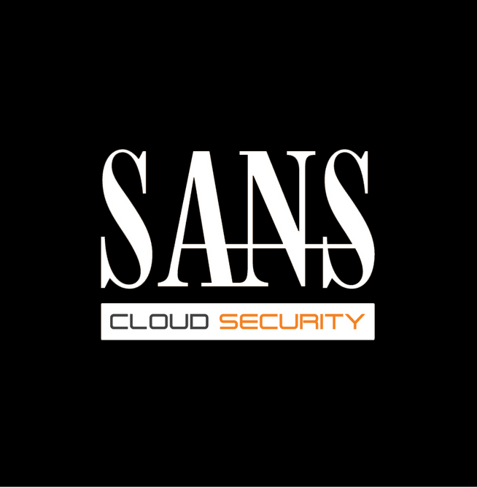








LONG COURSES
SEC488: Cloud Security Essentials
SEC584: Defending Cloud Native Infrastructure
Learning the language of Cloud
Deploy fast. Deploy secure.
SEC510: Multicloud Security Assessment & Defense
MGT516: Managing Security Vulnerabilities: Enterprise & Cloud
Multiple clouds require multiple solutions.
Stop treating the symptoms. Cure the disease.
RESOURCES
SEC522: Defending Web Applications Security Essentials
Not a matter of "if" but "when". Be prepared for a web app attack. We'll teach you how.
SHORT COURSES
sans.org/cloud-security
SANS Cloud Security
SEC540: Cloud Security and DevOps Automation
SEC534: Secure DevOps: A Practical Introduction
@SANSCloudSec
The cloud moves fast. Automate to keep up.
Principles! Practices! Tools! Oh My! Start your journey on the DevSecOps road here.
SANS Cloud Security
SEC545: Cloud Security Architecture & Operations
SEC541: Cloud Monitoring and Threat Hunting
Webcasts
In the Cloud, no one can hear you scream. Architect it properly and you won't have to.
You can run, but you can't hide! You're on our radar.
Blogs
SEC588: Cloud Penetration Testing
MGT520: Leading Cloud Security Design & Implementation
Aim your arrows to the sky and penetrate the Cloud.
Building and leading a cloud security program
Notes:
The SANS Institute, established in 1989 as a cooperative research and education organization, is the most trusted and by far the largest source for information security training and security certification in the world. It also develops, maintains, and makes available at no cost the largest collection of research documents about various aspects of information security, and it operates the internet's early warning system—the Internet Storm Center. Its programs now reach more than 165,000 security professionals around the world.
SANS offers a number of courses that teach developers, architects, testers, security professionals, and managers how to build more secure applications. Anyone involved in developing, securing, and defending applications can benefit from the following courses in the SANS Cloud Security Curriculum:
SEC488: Cloud Security Essentials:
Advise and speak about a wide range of cloud security topics and help your organization successfully navigate both the security challenges as well as the opportunities presented by cloud services.
SEC510: Multi-Cloud Security Assessment & Defense
Perform multi-cloud security assessments across AWS, Azure, and GCP clouds identifying key weaknesses and hardened configurations in core cloud services.
SEC540: Cloud Security & DevOps Automation
Provides development, operations, and security professionals with a methodology to build and deliver secure infrastructure and software using cloud services and DevSecOps workflows.

Slide 40

Questions?

